Slide 1

Harvard Business Review
How Smart,
Connected Products
Are Transforming Competition
Team members:
M10601011 何孟鐸
M10601014 高傲凡
M10701201 黃琮淇
M10601831 LE THIHUYNH ANH

Slide 2
CONTENT
1
What is third wave?
2
What are Smart, Connected Products?
3
The five forces that shape industry competition.
4
Implications for strategy.
2

Slide 3
Information technology is revolutionizing products.
→ “What business am I in?” ←
New functionality
Greater reliability
Higher product utilization
Capabilities that cut across and transcend traditional product boundaries
3

Slide 4






Sets of Strategic
How value is created and captured
How the prodigious amount of new and sensitive data is utilized and managed
How relationships with traditional business partners such as channels are redefined
What role companies should play as industry boundaries are expanded
Not the internet,
but the changing nature of the “things.”
IOT(Internet of things)
4

Slide 5
The third wave of IT-Driven competition
Manual, paperwork and verbal communication
IT
Manual, paperwork and verbal communication
The first wave of IT
1960s and 1970s
Standardization of processes
How to capture IT’s operational benefits while maintaining distinctive strategies
5

Slide 6
1980s and 1990s
Second wave of IT-driven transformation
Coordination and integration across individual activities and geography
6

Slide 7

Manual, paperwork and verbal communication
The third wave of IT
2014~
Sensors, processors, software, and connectivity in products, coupled with a product cloud
Changing product design, marketing, manufacturing, after-sale service and create the need for new activities such as data analytics and security
7

Slide 8
PART 02
What are Smart, Connected Products
?
8

Slide 9

Three components
Physical components
Comprise the product’s mechanical and electrical parts.
“Smart” components
Comprise the sensors, microprocessors, data storage, controls, software.
Connectivity components
An embedded operating system and enhanced user interface.
Comprise the ports, antennae, and protocols enabling wired or wireless connections with the product.
Amplifies the capabi-lities
and
value
9

Slide 10
Connectivity
Forms
Dual purpose
First, it allows information to be exchanged between the product and its operating environment, its maker, its users, and other products and systems.
Second, connectivity enables some functions of the product to exist outside the physical device, in what is known as the product cloud.
One-to-one
One-to-many
Many-to-many
10

Slide 11
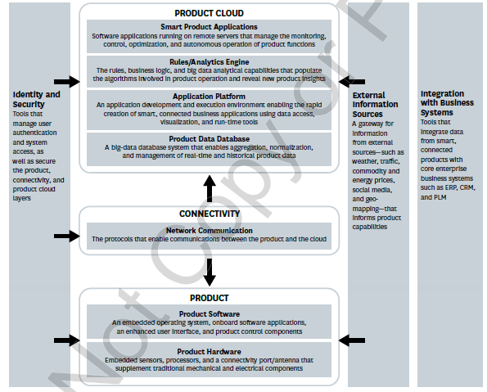

Technology stack
Why now?
Smart, connected products require that companies build an entirely new technology infrastructure, consisting of a series of layers known as a “technology stack”
11

Slide 12
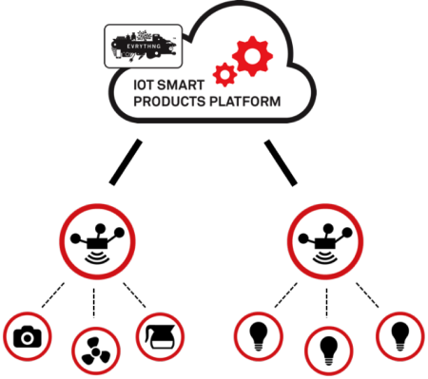
What Can Smart, Connected Products Do?
12

Slide 13
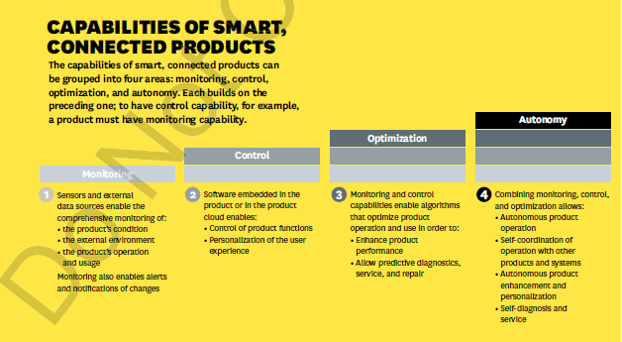


Capabilities of Smart, Connected Products
Monitoring.
Control.
Smart, connected products enable the comprehensive monitoring of a product’s condition, operation, and external environment through sensors and external data sources.
Smart, connected products can be controlled through remote commands or algorithms that are built into the device or reside in the product cloud.
Optimization.
Autonomy.
The rich flow of monitoring data from smart, connected products, coupled with the capacity to control product operation, allows companies to optimize product performance in numerous ways, many of which have not been previously possible.
Autonomy not only can reduce the need for operators but can improve safety in dangerous environments and facilitate operation in remote locations.
13

Slide 14
PART 03
The five forces that shape industry competition.
14

Slide 15
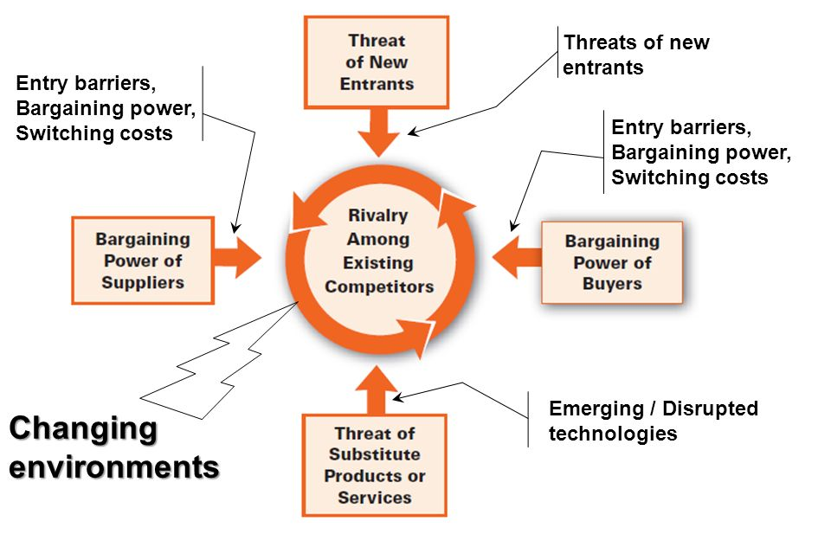
The five forces that shape industry competition
15

Slide 16

The five forces that shape industry competition
Bargaining power of buyers
Reduce company’s dependency on distribution or service partners
Expend opportunities for product differentiation, moving competition away from price alone
SMART, CONNECTED PRODUCTS
Develop much closer customer relationships
Enhance a company’s ability to segment customers, customize products, set prices, extend value added
16

Slide 17



The five forces that shape industry competition
Bargaining power of buyers
Giving buyers a better understanding of true product performance
Firstly
Increase buyer power
Having access to product usage data => decrease their reliance on the manufacture for advice and support
BY
Secondly
Finally
Reducing the cost of switching to a new manufacturer
17

Slide 18

The five forces that shape industry competition
Rivalry among competitors
Shift rivalry, opening up numerous new avenues for differentiation and value-added
1
SMART, CONNECTED PRODUCTS
Broaden the value proposition, enhance service
2
Become part of broader product system
3
18

Slide 19

The five forces that shape industry competition
Threat of new entrants
Facing significant new obstacles, starting with high fixed costs of more complex product design, embedded technology and multiple layers of new IT infrastructure
1
NEW ENTRANTS IN SMART, CONNECTED WORLD
2
Broadening product definition Raise barriers to entrants even higher
19
Notes:
Smart, connected product can reduce threat of new entrants

Slide 20

The five forces that shape industry competition
Create
Substitution threats and improve industry growth and profitability
Reducing
New types of substitution threats, such as wider product capabilities that subsume conventional products
Threat of substitutes
Creating new business models, such as Product-as-a-service business model
Example: Zipcar => car-sharing market
20

Slide 21


The five forces that shape industry competition
Bargaining power of suppliers
Shaking up traditional supplier relationships and redistributing bargaining power
High bargaining power of suppliers => capture bigger share of overall product value
Introducing powerful new suppliers that manufacturers have never needed before: sensors, software, connectivity,…
Good example of these new types of suppliers: Open Automotive Alliance
21

Slide 22
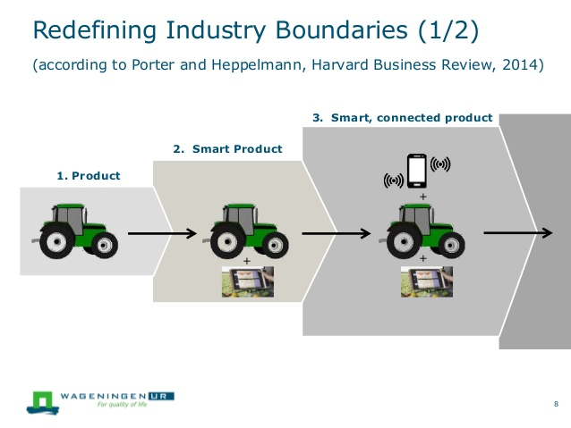
New industry boundaries and systems of systems
22

Slide 23
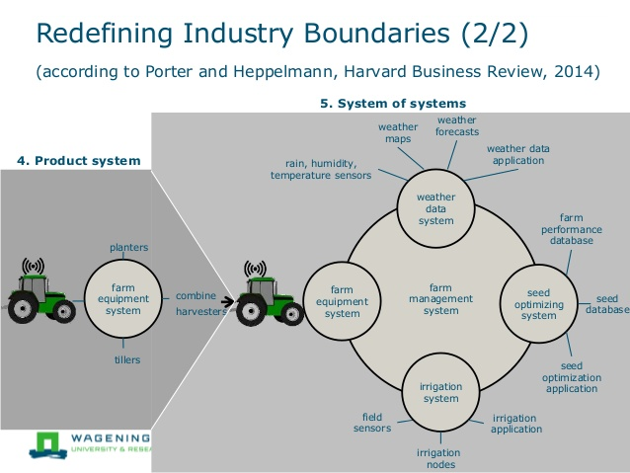
New industry boundaries and systems of systems
23

Slide 24
Smart, Connected Products and Competitive Advantage
Operational Effectiveness (OE)
best practices across the value chain
up-to-date product technologies, the latest production equipment, and state-of-the-art sales force methods, IT solutions, and supply chain management approaches.
basic of competition
competitors will implement the same best practices and catch up.
24

Slide 25
Smart, Connected Products and Competitive Advantage
Strategic Positioning
operational effectiveness is about doing things well, strategic positioning is about doing things differently.
strategy is to decide not only what to do but what not to do.
25

Slide 26
Design.
Design, service, marketing, human resources, and security
Achieve hardware standardization through software-based customization
Enable personalization
Incorporate the ability to support ongoing product upgrades
Enable predictive, enhanced, or remote service.
26

Slide 27
Design, service, marketing, human resources, and security
After-sale service.
New service organizational structures and delivery processes
Real-time product usage and performance data
Design for service
Early warnings about impending failure of parts or components
Product usage data
Data on product usage and performance
27

Slide 28
Design, service, marketing, human resources, and security
Marketing
Companies accumulate and analyze product usage data.
Using data analytics tools.
Security
Protect products against unauthorized use.
Secure access between the product technology stack and other corporate systems.
Human resources
Software development, systems engineering, product clouds, big data analytics, and other areas.
28

Slide 29
PART 04
Implications for Strategy.
29

Slide 30
1. Which set of smart, connected product capabilities and features should the company pursue?
First
Second
Third
It must decide which features will deliver real value to customers relative to their cost.
The value of features or capabilities will vary by market segment, and so the selection of features a company offers will depend on what segments it chooses to serve.
A company should incorporate those capabilities and features that reinforce its competitive positioning. A company competing with a high-end strategy can often reinforce differentiation through extensive features, while a low-cost competitor may choose to include only the most basic features that affect core product performance and that lower the cost of operation.
30

Slide 31

2. How much functionality should be embedded in the product and how much in the cloud?
Response time
A feature that requires quick response times.
Network availability, reliability, and security
Minimizing dependence on network availability and the amount of data that must flow from the product to cloud-based applications.
Automation
Products that are fully automated.
31

Slide 32
2. How much functionality should be embedded in the product and how much in the cloud?
Location of product use
Companies that operate products in remote or hazardous locations can mitigate the associated dangers and costs by hosting functionality in the product cloud.
Nature of user interface
The cloud offers the ability to deliver a much richer user experience and potentially to take advantage of an existing, familiar, and robust user interface like a smartphone.
Frequency of service or product upgrades
Cloud-based applications and interfaces allow companies to make product changes and upgrades easily and automatically.
32

Slide 33

3. Should the company pursue an open or closed system?
Purpose
A closed system approach aims to have customers purchase the entire smart, connected product system from a single manufacturer.
An open system, by contrast, enables the end customer to assemble the parts of the solution—both the products involved and the platform that ties the system together—from different companies.
Advantage
Closed systems create competitive advantage by allowing a company to control and optimize the design of all parts of the system relative to one another.
A fully open system enables any entity to participate in and interface with the system.
Derivative
A hybrid approach, in which a subset of functionality is open but the company controls access to full capabilities, occurs in industries like medical devices, where manufacturers support an industry standard interface but offer greater functionality only to customers.
33

Slide 34
4. Should the company develop the full set of smart, connected product capabilities and infrastructure internally or outsource to vendors and partners?
Trend
Developing the technology stack for smart, connected products requires significant investment in specialized skills, technologies, and infrastructure that have not been typically present in manufacturing companies.
Product Insight
Future Innovation
Opportunities
Competitive Advantage
Difficult
Skill
Cost
IT waves
Time
Consideration
However, best-of-breed vendors with turnkey connectivity solutions and product clouds, secure high-performance application platforms, and ready-to-use data analytics are emerging. This makes it increasingly challenging for in-house efforts to keep up and can turn an early lead into a disadvantage.
34

Slide 35



5. What data must the company capture, secure, and analyze to maximize the value of its offering?
Consideration
Requirement
Collecting data requires sensors, which add cost to the product, as does transmitting, storing, securing, and analyzing this data.
Companies must also consider the product integrity, security, or privacy risks for each type of data and the associated cost.
The types of data a company chooses to collect and analyze also depend on its positioning. If the company’s strategy is focused on leading in product performance or minimizing service cost, it must usually capture extensive “immediate value” data that can be leveraged in real time.
35

Slide 36

6. How does the company manage ownership and access rights to its product data?
The key is who actually owns the data.
Establishment
Companies may pursue outright ownership of product data, or seek joint ownership.
Providing information about the component’s condition and performance but not about its location.
Issue
The difficulty to get the data from customers.
Ongoing security risk is part of the business case for which data to collect and how to manage it.
36

Slide 37
7. Should the company fully or partially disintermediate distribution channels or service networks?
Disadvantages
Advantages
Customers must take delivery of and sometimes install a physical product, and some types of service visits are still necessary.
Assuming roles formerly handled by partners—such as direct selling or service—can be challenging, involving high start-up costs and major new investments in value chain functions such as sales, logistics, inventory, and infrastructure.
Decision making
Smart, connected products enable firms to maintain direct and deep customer relationships, which can reduce the need for distribution channel partners.
Companies can also diagnose product performance problems and failures and sometimes make repairs remotely, reducing reliance on service partners.
They can also improve their knowledge of customer needs, strengthen brand awareness, and boost loyalty by educating customers more directly about product value.
Do partners simply distribute products, or are they critical to delivering training and service in the field?
What percentage of partner activities can be replaced through smart, connected product capabilities?
Do customers understand the value of eliminating the middleman? Do customers understand that traditional relationships with established channels are no longer necessary and involve extra cost?
37

Slide 38
8. Should the company change its business model?
Previous
Nowadays
Alterations
Product sharing, a variation of the product-as-a-service model, focuses on more efficient utilization of products that are used intermittently.
Companies can also pursue hybrid models between the extremes of product-as-a-service and conventional ownership, such as product sales bundled with warranty or service contracts, or product sales bundled with performance-based contracts.
Manufacturers have traditionally focused on producing a physical good and capturing value by transferring ownership of the good to the customer through a sales transaction.
The product-as-a-service model in which the manufacturer retains ownership and takes full responsibility for the costs of product operation and service in return for an ongoing charge.
38

Slide 39

9. Should the company enter new businesses by monetizing its product data through selling it to outside parties?
The data companies accumulate from smart, connected products is valuable to entities besides traditional customers.
Companies can capture additional data that is valuable to other entities.
Data about the performance of a product’s components, for example, could be valuable to suppliers of those components.
New benefits
Problems
While some of customers may not care how their data is used, others may feel strongly about data privacy and reuse.
39

Slide 40
10. Should the company expand its scope?
Phenomenon
Efforts
Products that have been separate and distinct can become parts of optimized systems of related products, or components of systems of systems.
Shifting boundaries mean that companies that have been industry leaders for decades may find themselves playing more of a supporting role in a broader landscape.
Issue
Expanding product scope will be most attractive where there are major performance improvement opportunities through co-designing the related products to optimize the system.
A company may be better off sticking to its knitting and providing open connectivity to related products produced by others. Success is less a function of traditional product design than systems engineering.
Whether the company can assemble the necessary IT skills and technology, which are quite different from those required in product design and manufacturing.
Where system optimization takes place?
40

Slide 41
10. Should the company expand its scope?
Comparison
Inside Product
Outside Product
“Outside product” optimization takes place through the algorithms that connect products and other information, where products themselves are modular.
“Inside product” optimization involves integrating individual product designs so that products work better together.
Finally, as smart, connected products expand industry scope and the boundaries of competition, many companies will need to rethink their corporate purpose. The focus is shifting to the broader need companies meet, rather than their traditional product definition.
41

Slide 42
The Larger Opportunity
42

Slide 43
The past decade
Internal cost reduction
Cautious investment
Higher corporate profitability
Rising M&A
Muted innovation across large parts of the economy
This path has resulted in slower job growth, slower improvements in wages and living standards for the average citizen, a diminished sense of economic opportunity, doubts about capitalism, and reduced public support for business.
43

Slide 44
Change
Smart, connected products are changing how value is created for customers, how companies compete, and the boundaries of competition itself. These shifts will affect virtually every industry, directly or indirectly. But smart, connected products will have a broader impact even than this.
44

Slide 45
2014
Harvard Business Review
THANKS
45

